Slide 1
Basic Online Accessibility
A Quick Guide
Presented by: Carol Sparkes, PhD, Instructional Designer, Open Learning Carolyn Teare MSc, Manager Learning Technology & Innovation, Open Learning

Slide 2
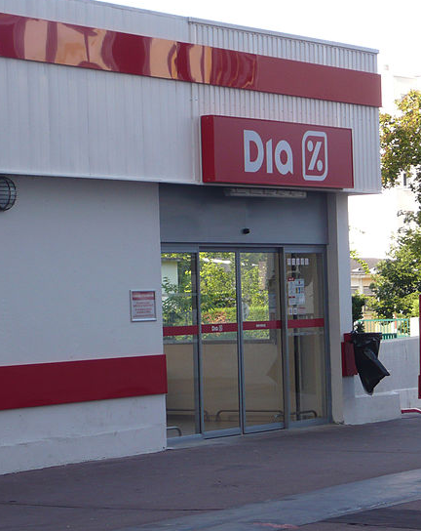
Alexmar983 [CC BY-SA (https://creativecommons.org/licenses/by-sa/3.0)]
Notes:
Accessibility and how it is different from Accommodation. Online accessibility is designing for the benefit of everyone (e.g., including transcripts for all videos), while accommodation is making changes after the fact (e.g., providing description of a diagram in a course only after someone explains that they cannot see it). This picture is of a physical accessible design, (i.e., a grocery store automatic door that opens for everyone).

Slide 3
Learning Outcomes
By the end of this session, you should be able to:
Recognize ways to improve accessibility in your online materials.
Document: structures
Media: Alternate Formats
Context: Complex Images (Diagrams/Charts)
Recall three good online accessibility resources

Slide 4
1. Document Structures: Use Proper Document Headings
Notes:
1. Document Structures
Document Structures: involve using proper document headings. In Microsoft Word these headings need to use styles (not font formatting). The navigation pane, the table of contents, and a screen reader need styles to work properly.

Slide 5
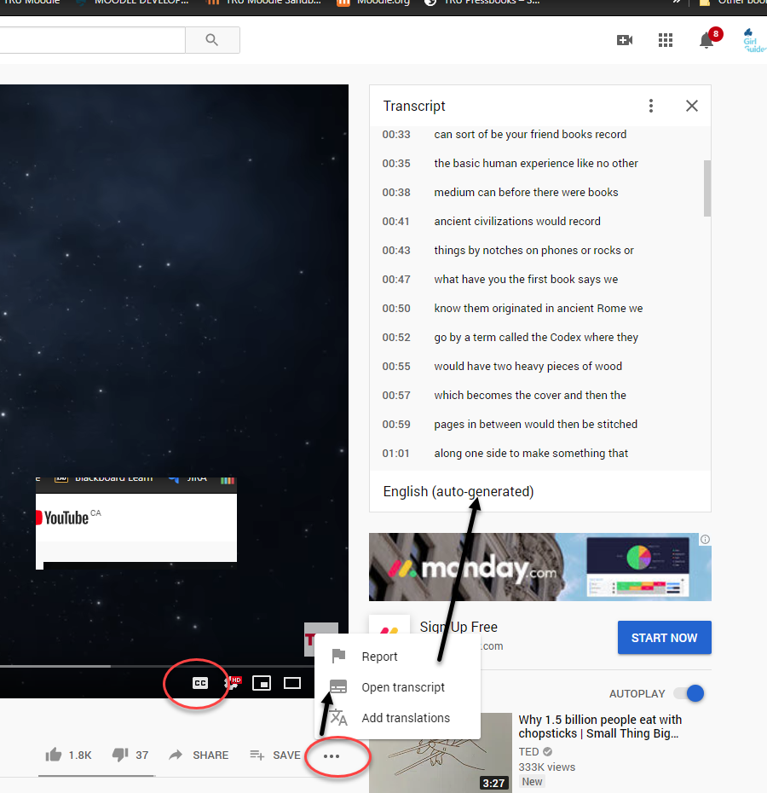
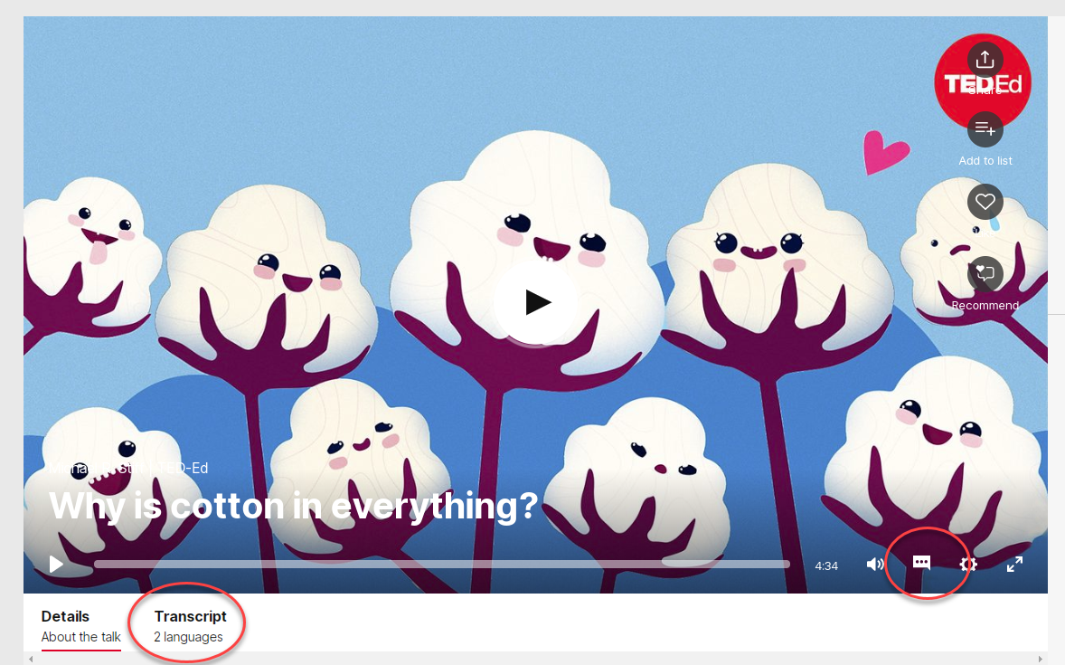
2. Media: Alternate Formats
Notes:
2. Media: Alternate formats
Images need alt-text. Alternative text
Video needs caption and transcripts

Slide 6
3. Context - links
https://www.tru.ca/current/academic-supports/as.html
OR
TRU Accessibility Services webpage
Notes:
3. Context - Links
Links should be context specific such as TRU Accessibility Services instead of URL https://www.tru.ca/current/academic-supports/as.html
A screen reader would read all the letters in a URL instead of a short title.
Also the user of a screen reader can ask it to read all the links on a page, so using words such as “Click here” are not helpful.

Slide 7
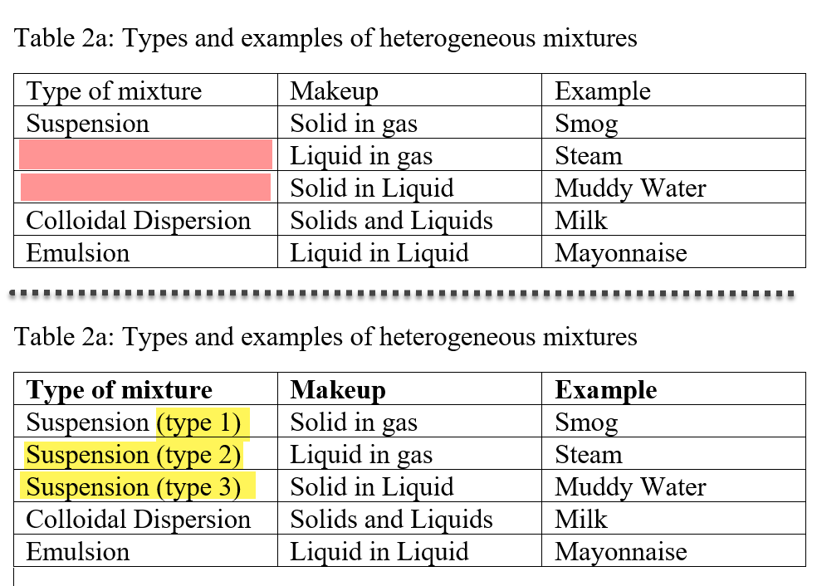
3. Context - tables
OR
Notes:
3. Context – tables.
Tables are best used for numerical data as opposed to organizing text. Empty cells in a table cause extra problems for screen readers. The better option is to use a list.

Slide 8
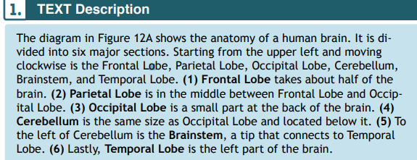
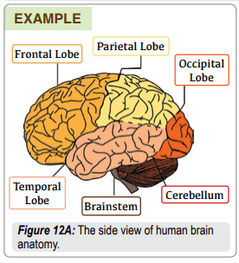
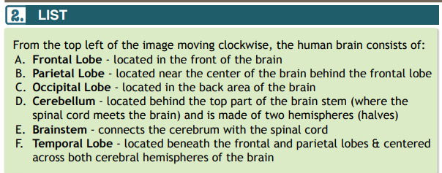
3. Context - diagrams
OR
Notes:
3. Context – diagrams.
See how the second list clearly outlines the parts of the brain diagram and provides as brief description.

Slide 9
Resources
BC Campus – Accessibility Toolkit – 2nd Edition
Portland Community College Resources
Web Accessibility Guidelines Handbook (PDF) (20 pages) 12 main areas including different types of files and accessibility checkers.
Complex Images for All Learners (PDF) (17 pages) (Tables/Charts/Math/Illustrations…)
Accessibility Services on Campus

Slide 10
Software
Microsoft Office Suite – Word/Excel/Powerpoint – all can check accessibility
Moodle – any time type content into editor – can check accessibility
Adobe Reader – under Edit & View Tabs
Read & Write – campus license
Notes:
Software
Microsoft Office Suite – Word/Excel/Powerpoint – all can check accessibility
Moodle – any time type content into editor – can check accessibility
Adobe Reader – under Edit & View Tabs
Read & Write – campus license

Slide 11
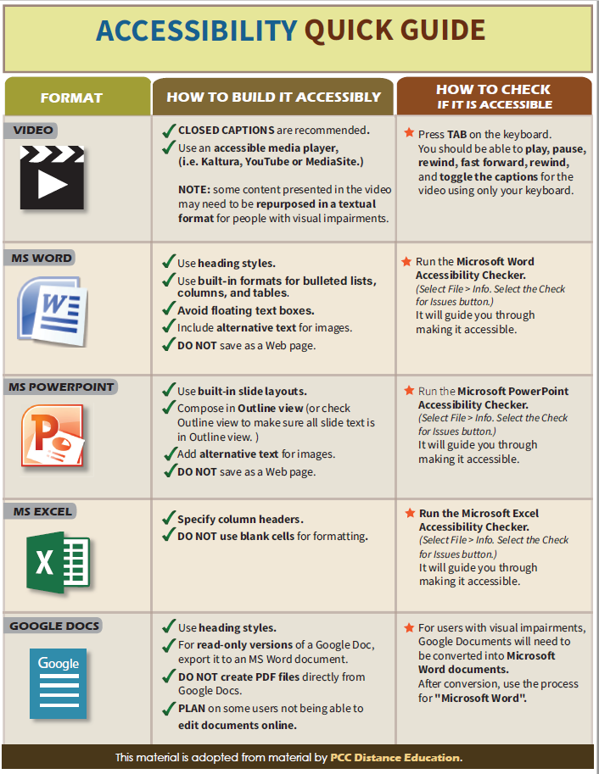
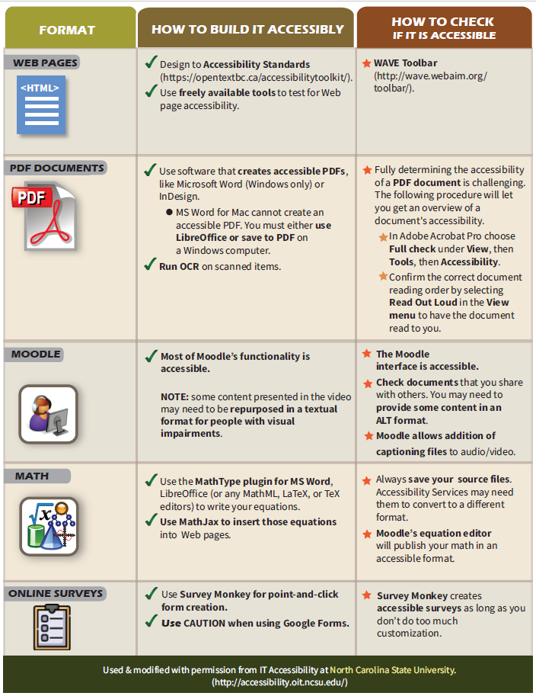
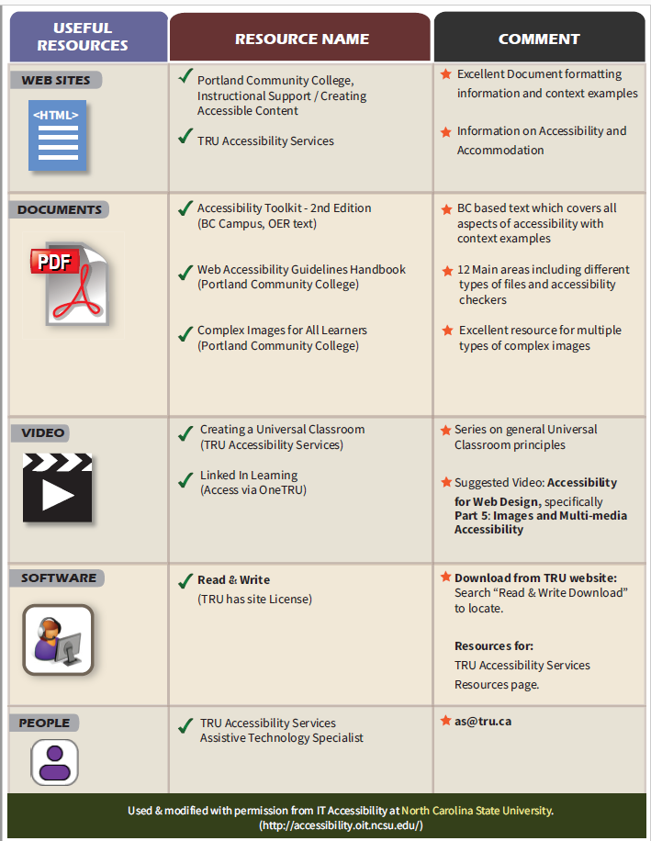
Accessibility Quick Reference Guide
Digital Copy available from: cteare@tru.ca

Slide 13
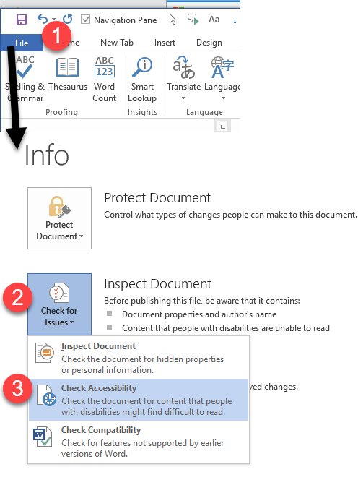
WORD/EXCEL/POWERPOINT

